Slide 1


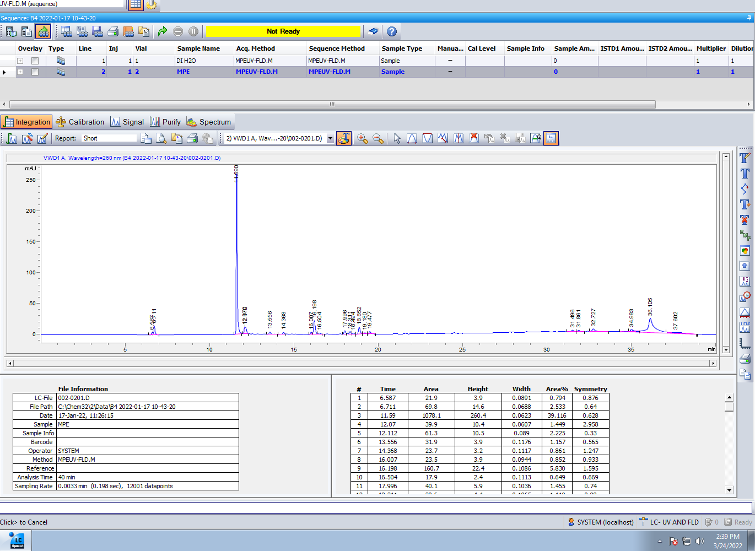
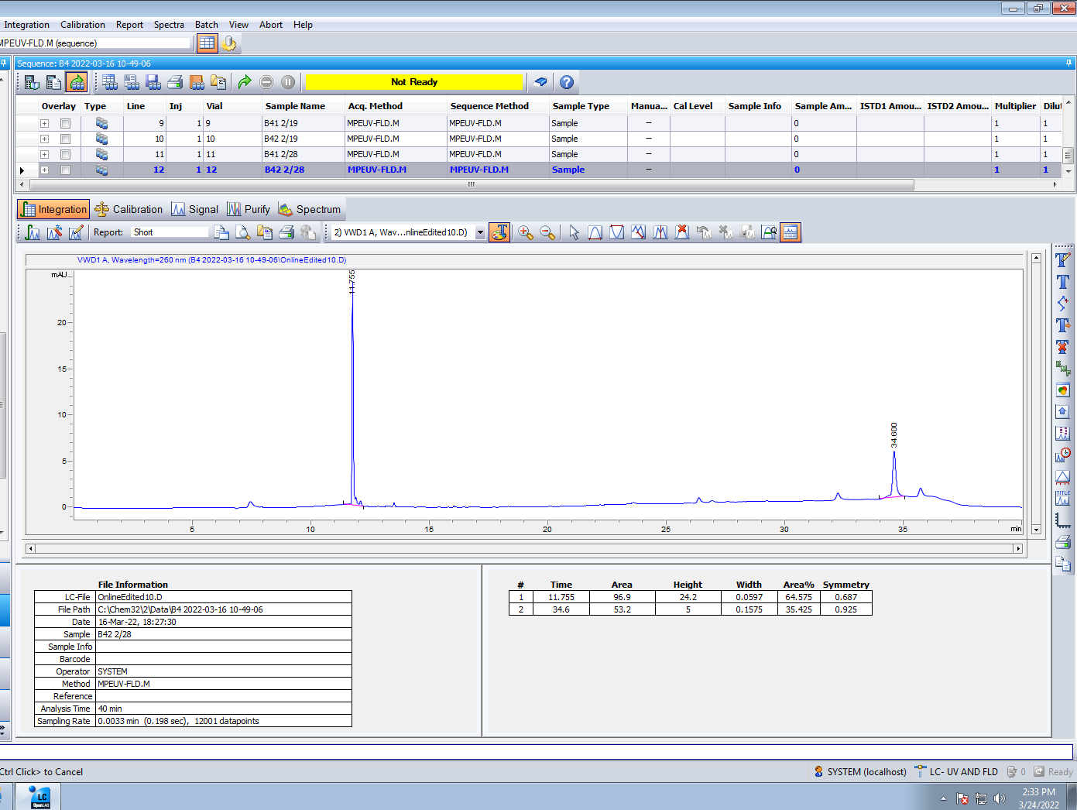
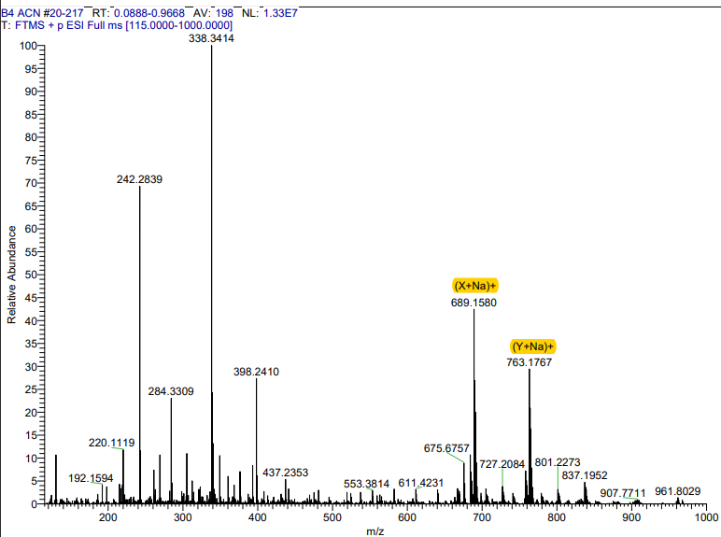
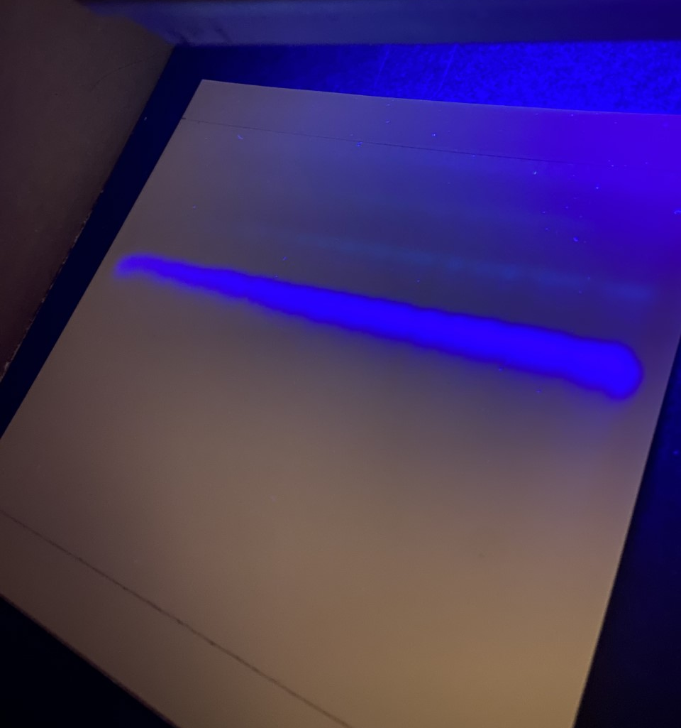
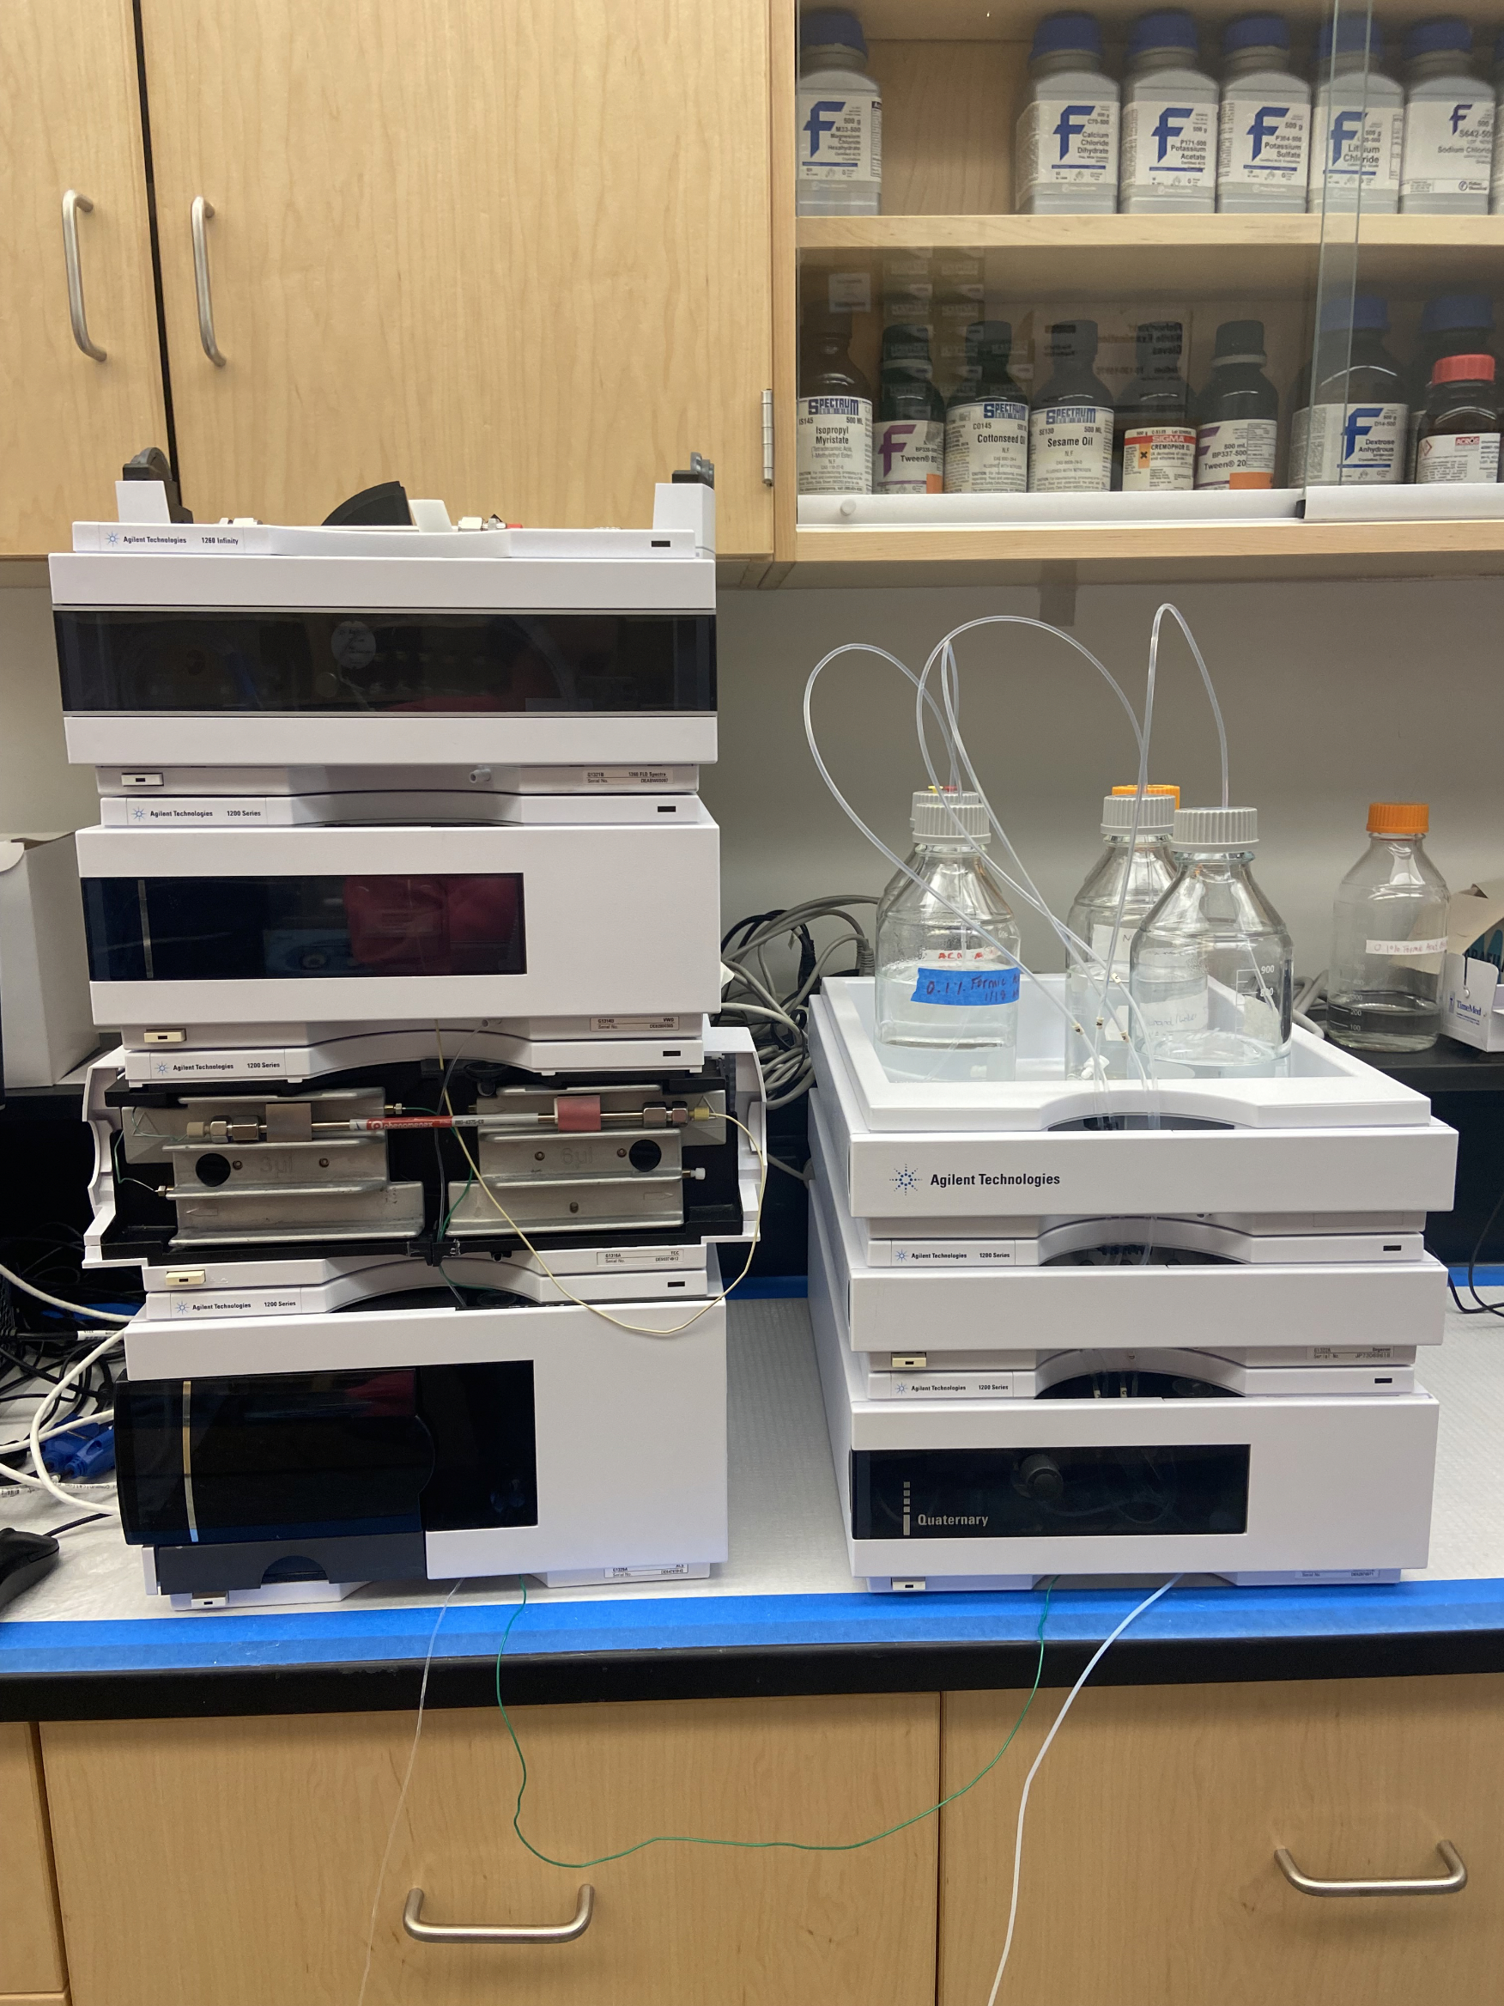
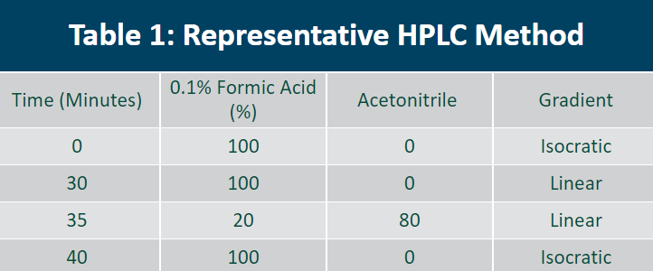
A thin layer chromatography purification method for peptide extracts from Sample M
Ali Goldensoph, Pharm.D. Candidate 2024; Abebe Mengesha, Ph.D.; Pramod Mahajan, Ph.D.
Drake University College of Pharmacy and Health Sciences , Des Moines, IA 50311
Abstract
Radiation-induced DNA-damage represents the ultimate form of insult to the cosmonauts’ genetic material because of the chronic and heritable health effects caused by such damage. Monitoring stability of DNA during and after space travel is therefore critical. Specific proteins, including proteases are involved in DNA repair, and could serve as biomarkers of radiation-induced DNA damage. We have recently identified a novel nuclear matrix metalloprotease (nMMP) activity possibly associated with DNA repair. Over the course of the first year and 5 months of this project, our team has developed an HPLC fractionation method for analysis of bioactive peptides. Our Sample “M” was treated with dichloromethane to remove lipids and other hydrophobic molecules and extracted with 100% methanol. Sample M has been further purified using a thin layer chromatography method. The extract was then fractionated on a C-18 flash column, and the fractions were analyzed using reverse-phase HPLC. Chromatographic resolution was achieved on a C18 column using a gradient mobile phase composed of 0.1% formic acid and acetonitrile. Major component of M1 was observed at a retention time of 11.7 minutes and was quantified using VWD detector at λmax of 260 nm. In collaboration with the University of Iowa, Sample M is undergoing further molecular identification with every submission of physical Sample M from our team.
Introduction
Prior to HPLC/TLC analysis
our peptide containing sample
“M” is treated with
dichloromethane and extracted
with 100% methanol.
This removes unwanted
lipids and other hydrophobic
materials. At this stage, the
sample is referred to as sample
"MP" and an initial elution profile is obtained using High-Pressure Liquid Chromatography (HPLC), as shown in figure 1A. At this point sample MP is lyophilized to a solid power form. From this starting point the sample is further purified using Thin Layer Chromatography (TLC). Purity is verified again using HPLC and a final purified elution profile of the same sample, referred to as 'B4' is obtained and shown in figure 1B. Once final purity is verified using HPLC the sample B4 is lyophilized again to the solid form. Initial mass spectrometry (MS) performed at the University of Iowa on sample B4 as shown in Figure 2.
Results
Thin Layer Chromatography Methods
Discussion
The high-pressure lipid chromatography method was developed after review of previously established HPLC methods for peptide analysis by Craik, Troeira Henriques, Mylne, and Wang (2012, pg. 37-62). The injection of a DI H₂0 blank was inserted to improve method clarity.
The displayed TLC Method is currently undergoing optimization. Comparison of pre-TLC HPLC analysis of sample MP in Figure 1A with post-TLC HPLC analysis of sample B4 displays purification of the sample. This is shown by the removal of minor peaks and subsequent preservation of the major peak, which is observed consistently at 10.7 min. In sample MP (figure 1A) the major
peak is 39.116% of sample composition compared to post-TLC purification (figure 1B) where the major peak is 81.234% of the sample's composition. The stability of the major peak is displayed in the absence of retention time variability between the pre- and post- purification chromatograms.
Initial MS analysis of sample B4 provides insight into the sample's molecular formulation. The two large peaks labeled in Figure 2 as (X+Na)+ and (Y+Na)+ are the largest peaks, therefore the peaks of major interest. Probable compositions with a Delta (mmu) closest to 0 are most likely to be the true molecular composition. The highest probability for the composition of (X+Na)+ at –0.41mmu is C₄₅H₂₂O₃N₄Na with a theoretical molecular weight of 666.1584u. For (Y+Na)+ the highest theoretical composition is C₅₄H₂₂N₅Na at –0.04mmu with a theoretical molecular weight of 740.1767u.
References
Craik, D.J., Troeira Henriques, S., Mylne, J.S., Wang, C.K. (2012). Cyclotide Isolation and Characterization. Methods in Enzymology, 156, 37-62. https://doi.org/10.1016/B978-0-12-394291-3.00024-1
Funding and Acknowledgements
This poster is based upon work supported by the Iowa Space Grant Consortium under NASA Award No. 80NSSC20M0107.
Any opinions, findings, and conclusions or recommendations expressed in this poster are those of the author(s) and do not necessarily reflect views of the NASA and/or Iowa Space Grant Consortium support or Iowa State University. As a team we thankfully acknowledge the support of this work from the NASA Iowa Space Grant Consortium through their generous funding.
The team would like to thank Lynn Teesch for their expert Mass Spectrometry analysis of sample B4, which took place at the University of Iowa.
Figure 1A: Chromatographic Elution Profile of Sample MP.
Figure 1B: Chromatographic Elution Profile of TLC Purified Sample B4.
B4
13.3cm
Image 2: Ultraviolet TLC Elution on silica gel plate.
Figure 2: HR ESI-MS - Full Scan Mass Spectrum of B4
Image 1: HPLC Equipment
~5mg of sample MP is weighed into a microcentrifuge tube.
200uL of DI H₂0 is transferred into the microcentrifuge tube.
150mL of 50/50 0.1% Formic Acid /100% Acetonitrile is used as the mobile phase.
A 50uL pipette is set to 25uL. This is used to load thin rows of sample MP onto the silica plate along the starting solvent front.
The plate is allowed to dry after each load.
Steps 4-5 are repeated until sample MP is depleted.
When the solvent front has reached the end of the labeled TLC plate, the plates are removed and allowed to dry. (Typical TLC completion occurs between 2 and 3 hours).
Plates are dried then placed under UV light in a dimly lit room. Shown in image 2 below.
At ~13.3cm a band appears, labeled 'B4'. This band is isolated and removed from the TLC plate.
The portion of B4 that is removed is dissolved in minimal DI H₂0 and agitated until dissolved.
The aqueous phase is removed and stored at –80°C until further analysis.
Table 1: Representative HPLC Method.
HPLC Methods
Flow rate: 0.5 mL/min
Gradient Elution Method as shown in Table 1
Injection volume: 10 μL
Detection: 260 nm
C18 Column
Each sample is run for 30 min. with a 10 min wash of 100% 0.1% Formic Acid to follow
Total run time: 40 min.
At the start of each HPLC run a blank of DI H₂0 is injected to equilibrate the system.

